Slide 1

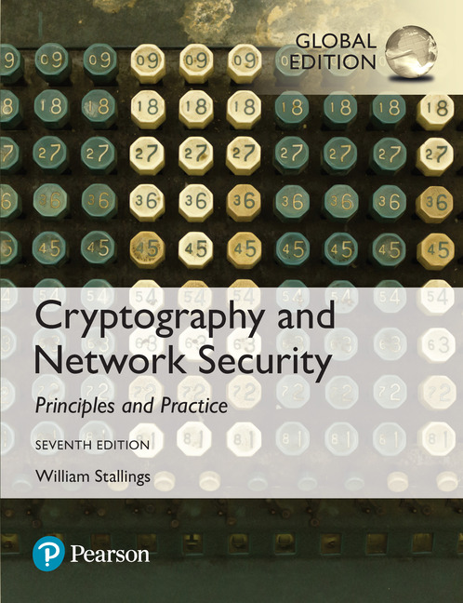
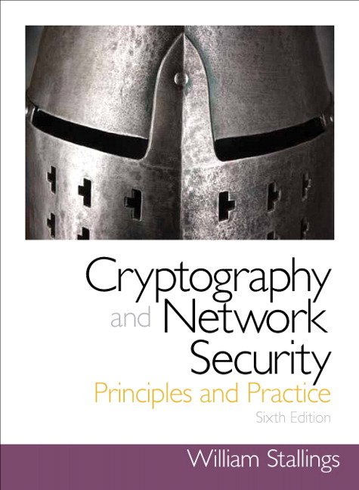
Cryptography and Network Security
Seventh Edition, Global Edition
by William Stallings
Notes:
Lecture slides prepared for “Cryptography and Network Security”, 7/e, by William Stallings, Chapter 15 – “User Authentication”.

Slide 2
Chapter 15
User Authentication
Notes:
This chapter examines some of the authentication functions that have been developed
to support network-based use authentication. The chapter begins with an introduction
to some of the concepts and key considerations for user authentication over a network
or the Internet. The next section examines user-authentication protocols that rely on
symmetric encryption. This is followed by a section on one of the earliest and also one
of the most widely used authentication services: Kerberos. Next, the chapter looks at
user-authentication protocols that rely on asymmetric encryption. This is followed by a
discussion of the X.509 user-authentication protocol. Finally, the concept of federated
identity is introduced.

Slide 3
Remote User-Authentication Principles
The process of verifying an identity claimed by or for a system entity
An authentication process consists of two steps:
Identification step
Presenting an identifier to the security system
Verification step
Presenting or generating authentication information that corroborates the binding between the entity and the identifier
Notes:
In most computer security contexts, user authentication is the fundamental building
block and the primary line of defense. User authentication is the basis for most
types of access control and for user accountability. RFC 4949 (Internet Security
Glossary ) defines user authentication as the process of verifying an identity claimed
by or for a system entity. This process consists of two steps:
■ Identification step: Presenting an identifier to the security system. (Identifiers
should be assigned carefully, because authenticated identities are the basis for
other security services, such as access control service.)
■ Verification step: Presenting or generating authentication information that
corroborates the binding between the entity and the identifier.
For example, user Alice Toklas could have the user identifier ABTOKLAS.
This information needs to be stored on any server or computer system that
Alice wishes to use and could be known to system administrators and other
users. A typical item of authentication information associated with this user
ID is a password, which is kept secret (known only to Alice and to the system).
If no one is able to obtain or guess Alice’s password, then the combination of
Alice’s user ID and password enables administrators to set up Alice’s access permissions
and audit her activity. Because Alice’s ID is not secret, system users
can send her e-mail, but because her password is secret, no one can pretend to
be Alice.
In essence, identification is the means by which a user provides a claimed
identity to the system; user authentication is the means of establishing the validity
of the claim. Note that user authentication is distinct from message authentication.
As defined in Chapter 12, message authentication is a procedure that allows communicating
parties to verify that the contents of a received message have not been
altered and that the source is authentic. This chapter is concerned solely with user
authentication.

Slide 4
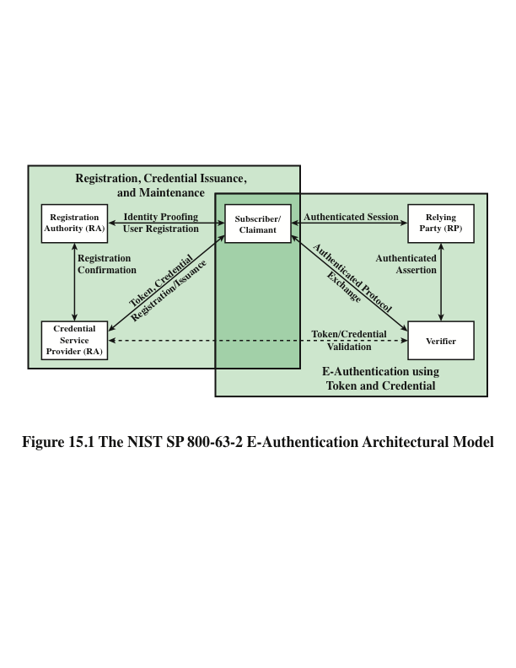
Notes:
NIST SP 800-63-2 (Electronic Authentication Guideline, August 2013) defines electronic
user authentication as the process of establishing confidence in user identities
that are presented electronically to an information system. Systems can use the
authenticated identity to determine if the authenticated individual is authorized to
perform particular functions, such as database transactions or access to system resources.
In many cases, the authentication and transaction or other authorized function
takes place across an open network such as the Internet. Equally authentication and
subsequent authorization can take place locally, such as across a local area network.
SP 800-63-2 defines a general model for user authentication that involves a number
of entities and procedures. We discuss this model with reference to Figure 15.1.
The initial requirement for performing user authentication is that the user
must be registered with the system. The following is a typical sequence for registration.
An applicant applies to a registration authority (RA) to become a subscriber
of a credential service provider (CSP) . In this model, the RA is a trusted entity that
establishes and vouches for the identity of an applicant to a CSP. The CSP then
engages in an exchange with the subscriber. Depending on the details of the overall
authentication system, the CSP issues some sort of electronic credential to the
subscriber. The credential is a data structure that authoritatively binds an identity
and additional attributes to a token possessed by a subscriber, and can be verified
when presented to the verifier in an authentication transaction. The token could
be an encryption key or an encrypted password that identifies the subscriber. The
token may be issued by the CSP, generated directly by the subscriber, or provided
by a third party. The token and credential may be used in subsequent authentication
events.
Once a user is registered as a subscriber, the actual authentication process can
take place between the subscriber and one or more systems that perform authentication
and, subsequently, authorization. The party to be authenticated is called a
claimant and the party verifying that identity is called a verifier . When a claimant
successfully demonstrates possession and control of a token to a verifier through an
authentication protocol, the verifier can verify that the claimant is the subscriber
named in the corresponding credential. The verifier passes on an assertion about the
identity of the subscriber to the relying party (RP) . That assertion includes identity
information about a subscriber, such as the subscriber name, an identifier assigned
at registration, or other subscriber attributes that were verified in the registration
process. The RP can use the authenticated information provided by the verifier to
make access control or authorization decisions.
An implemented system for authentication will differ from or be more complex
than this simplified model, but the model illustrates the key roles and functions
needed for a secure authentication system.

Slide 5
Means of User Authentication
For network-based user authentication, the most important methods involve cryptographic keys and something the individual knows, such as a password
There are four general means of authenticating a user’s identity, which can be used alone or in combination
Something the individual knows
Examples include a password, a personal identification number (PIN), or answers to a prearranged set of questions
Something the individual possesses
Examples include cryptographic keys, electronic keycards, smart cards, and physical keys
This is referred to as a token
Something the individual is (static biometrics)
Examples include recognition by fingerprint, retina, and face
Something the individual does (dynamic biometrics)
Examples include recognition by voice pattern, handwriting characteristics, and typing rhythm
Notes:
There are four general means of authenticating a user’s identity, which can be
used alone or in combination:
• Something the individual knows: Examples include a password, a personal
identification number (PIN), or answers to a prearranged set of questions.
• Something the individual possesses: Examples include cryptographic keys,
electronic keycards, smart cards, and physical keys. This type of authenticator
is referred to as a token .
• Something the individual is (static biometrics): Examples include recognition
by fingerprint, retina, and face.
• Something the individual does (dynamic biometrics): Examples include recognition
by voice pattern, handwriting characteristics, and typing rhythm.
All of these methods, properly implemented and used, can provide secure
user authentication. However, each method has problems. An adversary may be
able to guess or steal a password. Similarly, an adversary may be able to forge or
steal a token. A user may forget a password or lose a token. Furthermore, there is a
significant administrative overhead for managing password and token information
on systems and securing such information on systems. With respect to biometric authenticators,
there are a variety of problems, including dealing with false positives
and false negatives, user acceptance, cost, and convenience. For network-based user
authentication, the most important methods involve cryptographic keys and something
the individual knows, such as a password.

Slide 6
Mutual Authentication
Protocols which enable communicating parties to satisfy themselves mutually about each other’s identity and to exchange session keys
Central to the problem of authenticated key exchange are two issues:
Confidentiality
Essential identification and session-key information must be communicated in encrypted form
This requires the prior existence of secret or public keys that can be used for this purpose
Timeliness
Important because of the threat of message replays
Such replays could allow an opponent to:
successfully impersonate another party
disrupt operations by presenting parties with messages that appear genuine but are not
compromise a session key
Notes:
An important application area is that of mutual authentication protocols. Such
protocols enable communicating parties to satisfy themselves mutually about each
other’s identity and to exchange session keys. This topic was examined in Chapter 14.
There, the focus was key distribution. We return to this topic here to consider the
wider implications of authentication.
Central to the problem of authenticated key exchange are two issues: confidentiality
and timeliness. To prevent masquerade and to prevent compromise of session
keys, essential identification and session-key information must be communicated in encrypted
form. This requires the prior existence of secret or public keys that can be used
for this purpose. The second issue, timeliness, is important because of the threat of message
replays. Such replays, at worst, could allow an opponent to compromise a session
key or successfully impersonate another party. At minimum, a successful replay can
disrupt operations by presenting parties with messages that appear genuine but are not.

Slide 7
Replay Attacks
1. The simplest replay attack is one in which the opponent simply copies a message and replays it later
2. An opponent can replay a timestamped message within the valid time window
3. An opponent can replay a timestamped message within the valid time window, but in addition, the opponent suppresses the original message; thus, the repetition cannot be detected
4. Another attack involves a backward replay without modification and is possible if symmetric encryption is used and the sender cannot easily recognize the difference between messages sent and messages received on the basis of content
Notes:
[GONG93] lists the following examples of replay attacks:
1. The simplest replay attack is one in which the opponent simply copies a
message and replays it later.
2. An opponent can replay a timestamped message within the valid time
window. If both the original and the replay arrive within then time window,
this incident can be logged.
3. As with example (2), an opponent can replay a timestamped message within
the valid time window, but in addition, the opponent suppresses the original
message. Thus, the repetition cannot be detected.
4. Another attack involves a backward replay without modification. This is a
replay back to the message sender. This attack is possible if symmetric encryption
is used and the sender cannot easily recognize the difference between
messages sent and messages received on the basis of content.

Slide 8
Approaches to Coping With Replay Attacks
Attach a sequence number to each message used in an authentication exchange
A new message is accepted only if its sequence number is in the proper order
Difficulty with this approach is that it requires each party to keep track of the last sequence number for each claimant it has dealt with
Generally not used for authentication and key exchange because of overhead
Timestamps
Requires that clocks among the various participants be synchronized
Party A accepts a message as fresh only if the message contains a timestamp that, in A’s judgment, is close enough to A’s knowledge of current time
Challenge/response
Party A, expecting a fresh message from B, first sends B a nonce (challenge) and requires that the subsequent message (response) received from B contain the correct nonce value
Notes:
One approach to coping with replay attacks is to attach a sequence number to
each message used in an authentication exchange. A new message is accepted only if
its sequence number is in the proper order. The difficulty with this approach is that
it requires each party to keep track of the last sequence number for each claimant it
has dealt with. Because of this overhead, sequence numbers are generally not used
for authentication and key exchange. Instead, one of the following two general approaches
is used:
• Timestamps: Party A accepts a message as fresh only if the message contains a
timestamp that, in A’s judgment, is close enough to A’s knowledge of current
time. This approach requires that clocks among the various participants be
synchronized.
• Challenge/response: Party A, expecting a fresh message from B, first sends
B a nonce (challenge) and requires that the subsequent message (response)
received from B contain the correct nonce value.
It can be argued (e.g., [LAM92a]) that the timestamp approach should not be
used for connection-oriented applications because of the inherent difficulties with this
technique. First, some sort of protocol is needed to maintain synchronization among
the various processor clocks. This protocol must be both fault tolerant, to cope with
network errors, and secure, to cope with hostile attacks. Second, the opportunity for
a successful attack will arise if there is a temporary loss of synchronization resulting
from a fault in the clock mechanism of one of the parties. Finally, because of the
variable and unpredictable nature of network delays, distributed clocks cannot be
expected to maintain precise synchronization. Therefore, any timestamp-based procedure
must allow for a window of time sufficiently large to accommodate network
delays yet sufficiently small to minimize the opportunity for attack.
On the other hand, the challenge-response approach is unsuitable for a connectionless
type of application, because it requires the overhead of a handshake before
any connectionless transmission, effectively negating the chief characteristic of
a connectionless transaction. For such applications, reliance on some sort of secure
time server and a consistent attempt by each party to keep its clocks in synchronization
may be the best approach (e.g., [LAM92b]).

Slide 9
One-Way Authentication
One application for which encryption is growing in popularity is electronic mail (e-mail)
Header of the e-mail message must be in the clear so that the message can be handled by the store-and-forward e-mail protocol, such as SMTP or X.400
The e-mail message should be encrypted such that the mail-handling system is not in possession of the decryption key
A second requirement is that of authentication
The recipient wants some assurance that the message is from the alleged sender
Notes:
One application for which encryption is growing in popularity is electronic mail
(e-mail). The very nature of electronic mail, and its chief benefit, is that it is not necessary
for the sender and receiver to be online at the same time. Instead, the e-mail
message is forwarded to the receiver’s electronic mailbox, where it is buffered until
the receiver is available to read it.
The “envelope” or header of the e-mail message must be in the clear, so that
the message can be handled by the store-and-forward e-mail protocol, such as the
Simple Mail Transfer Protocol (SMTP) or X.400. However, it is often desirable that
the mail-handling protocol not require access to the plaintext form of the message,
because that would require trusting the mail-handling mechanism. Accordingly, the
e-mail message should be encrypted such that the mail-handling system is not in
possession of the decryption key.
A second requirement is that of authentication . Typically, the recipient wants
some assurance that the message is from the alleged sender.

Slide 10
Remote User-Authentication Using Symmetric Encryption
A two-level hierarchy of symmetric keys can be used to provide confidentiality for communication in a distributed environment
Strategy involves the use of a trusted key distribution center (KDC)
Each party shares a secret key, known as a master key, with the KDC
KDC is responsible for generating keys to be used for a short time over a connection between two parties and for distributing those keys using the master keys to protect the distribution
Notes:
As was discussed in Chapter 14, a two-level hierarchy of symmetric encryption keys
can be used to provide confidentiality for communication in a distributed environment.
In general, this strategy involves the use of a trusted key distribution center
(KDC). Each party in the network shares a secret key, known as a master key, with
the KDC. The KDC is responsible for generating keys to be used for a short time
over a connection between two parties, known as session keys, and for distributing
those keys using the master keys to protect the distribution. This approach is quite
common. As an example, we look at the Kerberos system in Section 15.3. The discussion
in this subsection is relevant to an understanding of the Kerberos mechanisms.

Slide 11
Suppress-Replay Attacks
The Denning protocol requires reliance on clocks that are synchronized throughout the network
A risk involved is based on the fact that the distributed clocks can become unsynchronized as a result of sabotage on or faults in the clocks or the synchronization mechanism
The problem occurs when a sender’s clock is ahead of the intended recipient’s clock
An opponent can intercept a message from the sender and replay it later when the timestamp in the message becomes current at the recipient’s site
Such attacks are referred to as suppress-replay attacks
Notes:
The Denning protocol seems to provide an increased degree of security compared
to the Needham/Schroeder protocol. However, a new concern is raised:
namely, that this new scheme requires reliance on clocks that are synchronized
throughout the network. [GONG92] points out a risk involved. The risk is based
on the fact that the distributed clocks can become unsynchronized as a result of
sabotage on or faults in the clocks or the synchronization mechanism. The problem
occurs when a sender’s clock is ahead of the intended recipient’s clock. In this case,
an opponent can intercept a message from the sender and replay it later when the
timestamp in the message becomes current at the recipient’s site. This replay could
cause unexpected results. Gong refers to such attacks as suppress-replay attacks .
One way to counter suppress-replay attacks is to enforce the requirement that
parties regularly check their clocks against the KDC’s clock. The other alternative,
which avoids the need for clock synchronization, is to rely on handshaking protocols
using nonces. This latter alternative is not vulnerable to a suppress-replay attack,
because the nonces the recipient will choose in the future are unpredictable to the
sender. The Needham/Schroeder protocol relies on nonces only but, as we have
seen, has other vulnerabilities.

Slide 12
Kerberos
Authentication service developed as part of Project Athena at MIT
A workstation cannot be trusted to identify its users correctly to network services
A user may gain access to a particular workstation and pretend to be another user operating from that workstation
A user may alter the network address of a workstation so that the requests sent from the altered workstation appear to come from the impersonated workstation
A user may eavesdrop on exchanges and use a replay attack to gain entrance to a server or to disrupt operations
Kerberos provides a centralized authentication server whose function is to authenticate users to servers and servers to users
Relies exclusively on symmetric encryption, making no use of public-key encryption
Notes:
Kerberos is an authentication service developed as part of Project Athena at MIT.
The problem that Kerberos addresses is this: Assume an open distributed environment
in which users at workstations wish to access services on servers distributed
throughout the network. We would like for servers to be able to restrict access to
authorized users and to be able to authenticate requests for service. In this environment,
a workstation cannot be trusted to identify its users correctly to network
services. In particular, the following three threats exist:
1. A user may gain access to a particular workstation and pretend to be another
user operating from that workstation.
2. A user may alter the network address of a workstation so that the requests
sent from the altered workstation appear to come from the impersonated
workstation.
3. A user may eavesdrop on exchanges and use a replay attack to gain entrance
to a server or to disrupt operations.
In any of these cases, an unauthorized user may be able to gain access to services
and data that he or she is not authorized to access. Rather than building in elaborate
authentication protocols at each server, Kerberos provides a centralized authentication
server whose function is to authenticate users to servers and servers to users.
Unlike most other authentication schemes described in this book, Kerberos relies
exclusively on symmetric encryption, making no use of public-key encryption.
Two versions of Kerberos are in common use. Version 4 [MILL88, STEI88]
implementations still exist. Version 5 [KOHL94] corrects some of the security deficiencies
of version 4 and has been issued as a proposed Internet Standard (RFC 4120
and RFC 4121).

Slide 13
Kerberos Requirements
The first published report on Kerberos listed the following requirements:
Secure
A network eavesdropper should not be able to obtain the necessary information to impersonate a user
Reliable
Should be highly reliable and should employ a distributed server architecture with one system able to back up another
Transparent
Ideally, the user should not be aware that authentication is taking place beyond the requirement to enter a password
Scalable
The system should be capable of supporting large numbers of clients and servers
Notes:
Kerberos assumes a distributed client/server architecture and employs one or more Kerberos servers to
provide an authentication service.
The first published report on Kerberos [STEI88] listed the following
requirements.
• Secure: A network eavesdropper should not be able to obtain the necessary
information to impersonate a user. More generally, Kerberos should be strong
enough that a potential opponent does not find it to be the weak link.
• Reliable: For all services that rely on Kerberos for access control, lack of
availability of the Kerberos service means lack of availability of the supported
services. Hence, Kerberos should be highly reliable and should employ a distributed
server architecture with one system able to back up another.
• Transparent: Ideally, the user should not be aware that authentication is taking
place beyond the requirement to enter a password.
• Scalable: The system should be capable of supporting large numbers of clients
and servers. This suggests a modular, distributed architecture.
To support these requirements, the overall scheme of Kerberos is that of a
trusted third-party authentication service that uses a protocol based on that proposed
by Needham and Schroeder [NEED78], which was discussed in Section 15.2.
It is trusted in the sense that clients and servers trust Kerberos to mediate their
mutual authentication. Assuming the Kerberos protocol is well designed, then the
authentication service is secure if the Kerberos server itself is secure.

Slide 14
Kerberos Version 4
Makes use of DES to provide the authentication service
Authentication server (AS)
Knows the passwords of all users and stores these in a centralized database
Shares a unique secret key with each server
Ticket
Created once the AS accepts the user as authentic; contains the user’s ID and network address and the server’s ID
Encrypted using the secret key shared by the AS and the server
Ticket-granting server (TGS)
Issues tickets to users who have been authenticated to AS
Each time the user requires access to a new service the client applies to the TGS using the ticket to authenticate itself
The TGS then grants a ticket for the particular service
The client saves each service-granting ticket and uses it to authenticate its user to a server each time a particular service is requested
Notes:
Version 4 of Kerberos makes use of DES, in a rather elaborate protocol, to provide
the authentication service. Viewing the protocol as a whole, it is difficult to see the
need for the many elements contained therein. Therefore, we adopt a strategy used
by Bill Bryant of Project Athena [BRYA88] and build up to the full protocol by looking
first at several hypothetical dialogues. Each successive dialogue adds additional
complexity to counter security vulnerabilities revealed in the preceding dialogue.
In an unprotected network environment, any
client can apply to any server for service. The obvious security risk is that of impersonation.
An opponent can pretend to be another client and obtain unauthorized
privileges on server machines. To counter this threat, servers must be able to
confirm the identities of clients who request service. Each server can be required to
undertake this task for each client/server interaction, but in an open environment,
this places a substantial burden on each server.
An alternative is to use an authentication server (AS) that knows the passwords
of all users and stores these in a centralized database. In addition, the AS
shares a unique secret key with each server. These keys have been distributed physically
or in some other secure manner.
The AS checks its database to see if the user has supplied the proper
password for this user ID and whether this user is permitted access to server V. If
both tests are passed, the AS accepts the user as authentic and must now convince
the server that this user is authentic. To do so, the AS creates a ticket that contains
the user’s ID and network address and the server’s ID. This ticket is encrypted
using the secret key shared by the AS and this server.
TGS, issues tickets to users who have been authenticated to
AS. Thus, the user first requests a ticket-granting ticket from the AS. The
client module in the user workstation saves this ticket. Each time the user requires
access to a new service, the client applies to the TGS, using the ticket to authenticate
itself. The TGS then grants a ticket for the particular service. The client saves
each service-granting ticket and uses it to authenticate its user to a server each time
a particular service is requested.
Because only the correct user should know the password, only the correct user
can recover the ticket. Thus, we have used the password to obtain credentials from
Kerberos without having to transmit the password in plaintext. The ticket itself
consists of the ID and network address of the user, and the ID of the TGS. This
corresponds to the first scenario. The idea is that the client can use this ticket to
request multiple service-granting tickets. So the ticket-granting ticket is to be reusable.
However, we do not wish an opponent to be able to capture the ticket and
use it. Consider the following scenario: An opponent captures the login ticket and
waits until the user has logged off his or her workstation. Then the opponent either
gains access to that workstation or configures his workstation with the same network
address as that of the victim. The opponent would be able to reuse the ticket
to spoof the TGS. To counter this, the ticket includes a timestamp, indicating the
date and time at which the ticket was issued, and a lifetime, indicating the length
of time for which the ticket is valid (e.g., eight hours). Thus, the client now has a
reusable ticket and need not bother the user for a password for each new service
request. Finally, note that the ticket-granting ticket is encrypted with a secret key
known only to the AS and the TGS. This prevents alteration of the ticket. The ticket
is reencrypted with a key based on the user’s password. This assures that the ticket
can be recovered only by the correct user, providing the authentication.
The service-granting ticket has the same structure as the ticket-granting ticket.
Indeed, because the TGS is a server, we would expect that the same elements are
needed to authenticate a client to the TGS and to authenticate a client to an application
server. Again, the ticket contains a timestamp and lifetime. If the user wants
access to the same service at a later time, the client can simply use the previously
acquired service-granting ticket and need not bother the user for a password. Note
that the ticket is encrypted with a secret key known only to the TGS and the
server, preventing alteration.

Slide 15
The Version 4 Authentication Dialogue
The lifetime associated with the ticket-granting ticket creates a problem:
If the lifetime is very short (e.g., minutes), the user will be repeatedly asked for a password
If the lifetime is long (e.g., hours), then an opponent has a greater opportunity for replay
A network service (the TGS or an application service) must be able to prove that the person using a ticket is the same person to whom that ticket was issued
Servers need to authenticate themselves to users
Notes:
The heart of the first problem is the lifetime associated with the ticket-granting ticket.
If this lifetime is very short (e.g., minutes), then the user will be repeatedly asked
for a password. If the lifetime is long (e.g., hours), then an opponent has a greater
opportunity for replay. An opponent could eavesdrop on the network and capture
a copy of the ticket-granting ticket and then wait for the legitimate user to log out.
Then the opponent could forge the legitimate user’s network address and send the
message of step (3) to the TGS. This would give the opponent unlimited access to
the resources and files available to the legitimate user.
Similarly, if an opponent captures a service-granting ticket and uses it before it
expires, the opponent has access to the corresponding service.
Thus, we arrive at an additional requirement. A network service (the TGS or
an application service) must be able to prove that the person using a ticket is the
same person to whom that ticket was issued.
The second problem is that there may be a requirement for servers to
authenticate themselves to users. Without such authentication, an opponent could
sabotage the configuration so that messages to a server were directed to another
location. The false server would then be in a position to act as a real server and
capture any information from the user and deny the true service to the user.

Slide 16
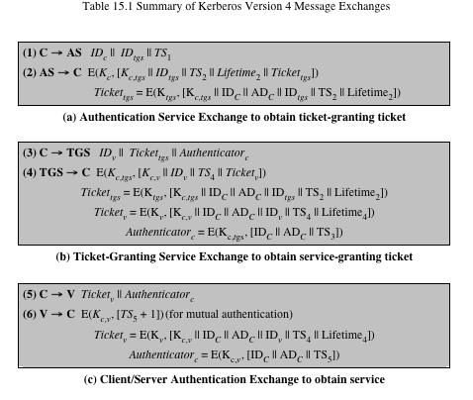
Table 15.1 (page 470 in textbook)
Summary of Kerberos Version 4 Message Exchanges
Notes:
Table 15.1, shows the actual Kerberos protocol.
Table 15.1a shows the technique for distributing the session key. As before,
the client sends a message to the AS requesting access to the TGS. The AS responds
with a message, encrypted with a key derived from the user’s password that
contains the ticket. The encrypted message also contains a copy of the session key,
where the subscripts indicate that this is a session key for C and TGS. Because
this session key is inside the message encrypted with K_{c} , only the user’s client can
read it. The same session key is included in the ticket, which can be read only by
the TGS. Thus, the session key has been securely delivered to both C and the TGS.
Armed with the ticket and the session key, C is ready to approach the TGS.
As before, C sends the TGS a message that includes the ticket plus the ID of the requested
service [message (3) in Table 15.1b].
The reply from the TGS in message (4) follows the form of message (2). The
message is encrypted with the session key shared by the TGS and C and includes
a session key to be shared between C and the server V, the ID of V, and the timestamp
of the ticket. The ticket itself includes the same session key.
C now has a reusable service-granting ticket for V. When C presents this ticket,
as shown in message (5), it also sends an authenticator. The server can decrypt the
ticket, recover the session key, and decrypt the authenticator.
If mutual authentication is required, the server can reply as shown in message
(6) of Table 15.1. The server returns the value of the timestamp from the authenticator,
incremented by 1, and encrypted in the session key. C can decrypt this message
to recover the incremented timestamp. Because the message was encrypted by
the session key, C is assured that it could have been created only by V. The contents
of the message assure C that this is not a replay of an old reply.
Finally, at the conclusion of this process, the client and server share a secret
key. This key can be used to encrypt future messages between the two or to exchange
a new random session key for that purpose.

Slide 17
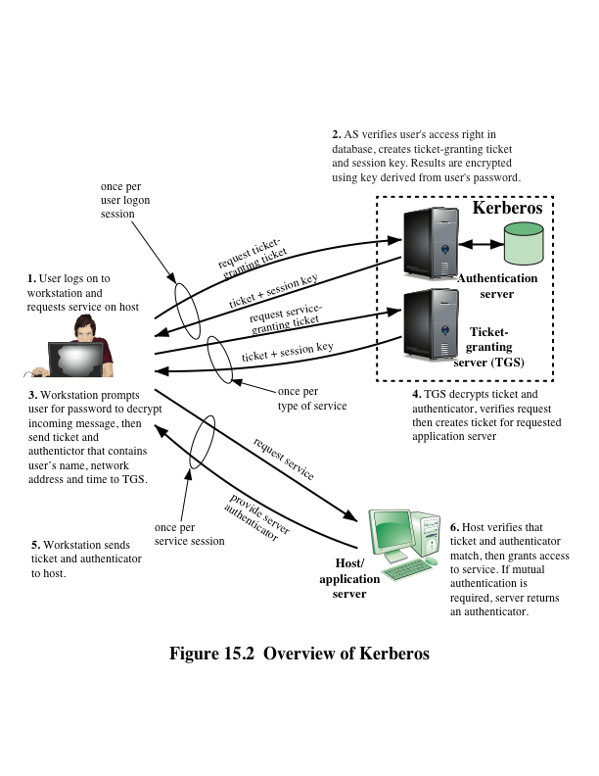
Notes:
Figure 15.2 provides an overview.
First, consider the problem of captured ticket-granting tickets and the need
to determine that the ticket presenter is the same as the client for whom the ticket
was issued. The threat is that an opponent will steal the ticket and use it before it
expires. To get around this problem, let us have the AS provide both the client and
the TGS with a secret piece of information in a secure manner. Then the client can
prove its identity to the TGS by revealing the secret information—again in a secure
manner. An efficient way of accomplishing this is to use an encryption key as the
secure information; this is referred to as a session key in Kerberos.

Slide 18
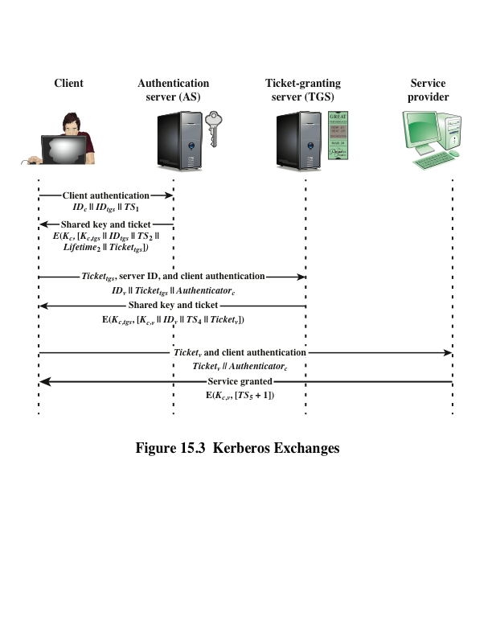
Notes:
Figure 15.3 illustrates the Kerberos exchanges among the parties.

Slide 19
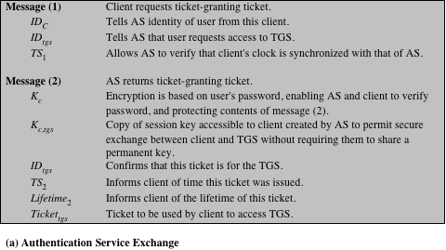
(This table can be found on pages 473 – 474 in the textbook)
Notes:
Table 15.2 summarizes the justification for each of the elements in the Kerberos protocol.
Page 1 – authentication service exchange

Slide 20
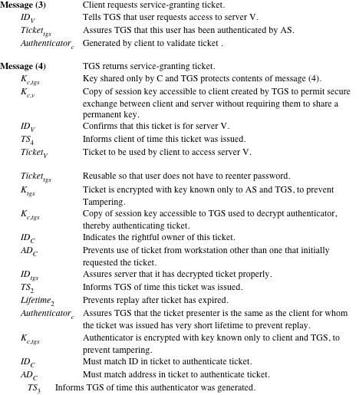
Notes:
Page 2 – ticket-granting service exchange

Slide 21
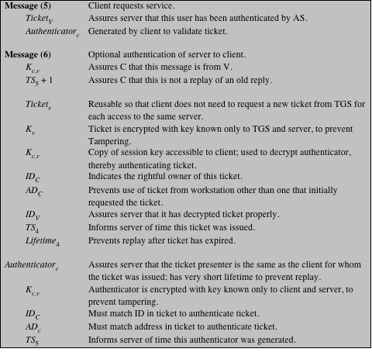
(page 3 of 3)
Notes:
Page 3 – client/server authentication exchange

Slide 22
Kerberos Realms and Multiple Kerberi
A full-service Kerberos environment consisting of a Kerberos server, a number of clients, and a number of application servers requires that:
The Kerberos server must have the user ID and hashed passwords of all participating users in its database; all users are registered with the Kerberos server
The Kerberos server must share a secret key with each server; all servers are registered with the Kerberos server
The Kerberos server in each interoperating realm shares a secret key with the server in the other realm; the two Kerberos servers are registered with each other
Notes:
A full-service Kerberos environment
consisting of a Kerberos server, a number of clients, and a number of application
servers requires the following:
1. The Kerberos server must have the user ID and hashed passwords of all participating
users in its database. All users are registered with the Kerberos server.
2. The Kerberos server must share a secret key with each server. All servers are
registered with the Kerberos server.
Networks of clients and servers under different administrative organizations
typically constitute different realms. That is, it generally is not practical or does not
conform to administrative policy to have users and servers in one administrative
domain registered with a Kerberos server elsewhere. However, users in one realm
may need access to servers in other realms, and some servers may be willing to provide
service to users from other realms, provided that those users are authenticated.
Kerberos provides a mechanism for supporting such interrealm authentication.
For two realms to support interrealm authentication, a third requirement is added:
3. The Kerberos server in each interoperating realm shares a secret key with the
server in the other realm. The two Kerberos servers are registered with each other.
The scheme requires that the Kerberos server in one realm trust the Kerberos
server in the other realm to authenticate its users. Furthermore, the participating
servers in the second realm must also be willing to trust the Kerberos server in the
first realm.

Slide 23
Kerberos Realm
A set of managed nodes that share the same Kerberos database
The database resides on the Kerberos master computer system, which should be kept in a physically secure room
A read-only copy of the Kerberos database might also reside on other Kerberos computer systems
All changes to the database must be made on the master computer system
Changing or accessing the contents of a Kerberos database requires the Kerberos master password
Notes:
A Kerberos realm is a set of managed nodes that
share the same Kerberos database. The Kerberos database resides on the Kerberos
master
computer system, which should be kept in a physically secure room. A read-only
copy of the Kerberos database might also reside on other Kerberos computer
systems. However, all changes to the database must be made on the master computer
system. Changing or accessing the contents of a Kerberos database requires
the Kerberos master password.

Slide 24
Kerberos Principal
Three parts of a principal name
A service or user name
An instance name
A realm name
A service or user that is known to the Kerberos system
Identified by its principal name
Notes:
A related concept is that of a Kerberos principal ,
which is a service or user that is known to the Kerberos system. Each Kerberos
principal is identified by its principal name. Principal names consist of three parts: a
service or user name, an instance name, and a realm name.

Slide 25
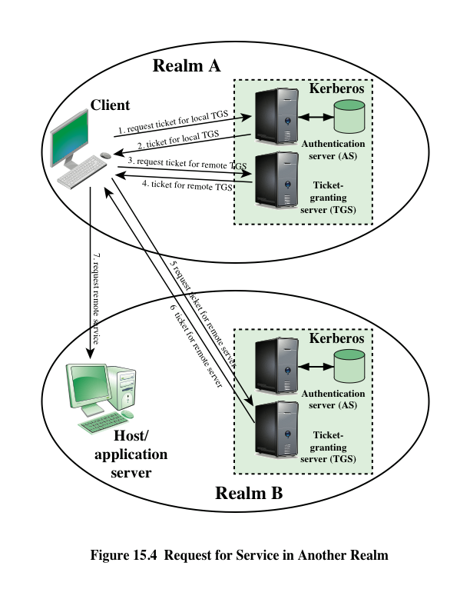
Notes:
With these ground rules in place, we can describe the mechanism as follows
(Figure 15.4): A user wishing service on a server in another realm needs a ticket for
that server. The user’s client follows the usual procedures to gain access to the local
TGS and then requests a ticket-granting ticket for a remote TGS (TGS in another
realm). The client can then apply to the remote TGS for a service-granting ticket for
the desired server in the realm of the remote TGS.

Slide 26
Differences Between Versions 4 and 5
Version 5 is intended to address the limitations of version 4 in two areas:
Environmental shortcomings
Encryption system dependence
Internet protocol dependence
Message byte ordering
Ticket lifetime
Authentication forwarding
Interrealm authentication
Technical deficiencies
Double encryption
PCBC encryption
Session keys
Password attacks
Notes:
Version 5 is intended to address the limitations
of version 4 in two areas: environmental shortcomings and technical deficiencies.
Let us briefly summarize the improvements in each area.
Kerberos version 4 was developed for use within the Project Athena environment
and, accordingly, did not fully address the need to be of general purpose. This
led to the following environmental shortcomings .
1. Encryption system dependence: Version 4 requires the use of DES. Export
restriction on DES as well as doubts about the strength of DES were thus of
concern. In version 5, ciphertext is tagged with an encryption-type identifier so
that any encryption technique may be used. Encryption keys are tagged with a
type and a length, allowing the same key to be used in different algorithms and
allowing the specification of different variations on a given algorithm.
2. Internet protocol dependence: Version 4 requires the use of Internet Protocol
(IP) addresses. Other address types, such as the ISO network address, are not
accommodated. Version 5 network addresses are tagged with type and length,
allowing any network address type to be used.
3. Message byte ordering: In version 4, the sender of a message employs a byte
ordering of its own choosing and tags the message to indicate least significant
byte in lowest address or most significant byte in lowest address. This techniques
works but does not follow established conventions. In version 5, all message
structures are defined using Abstract Syntax Notation One (ASN.1) and
Basic Encoding Rules (BER), which provide an unambiguous byte ordering.
4. Ticket lifetime: Lifetime values in version 4 are encoded in an 8-bit quantity
in units of five minutes. Thus, the maximum lifetime that can be expressed is
2⁸ * 5 = 1280 minutes (a little over 21 hours). This may be inadequate for
some applications (e.g., a long-running simulation that requires valid Kerberos
credentials throughout execution). In version 5, tickets include an explicit start
time and end time, allowing tickets with arbitrary lifetimes.
5. Authentication forwarding: Version 4 does not allow credentials issued to one
client to be forwarded to some other host and used by some other client. This
capability would enable a client to access a server and have that server access
another server on behalf of the client. For example, a client issues a request to
a print server that then accesses the client’s file from a file server, using the client’s
credentials for access. Version 5 provides this capability.
6. Interrealm authentication: In version 4, interoperability among N realms
requires on the order of N² Kerberos-to-Kerberos relationships, as described
earlier. Version 5 supports a method that requires fewer relationships, as
described shortly.
Apart from these environmental limitations, there are technical deficiencies
in the version 4 protocol itself. Most of these deficiencies were documented in
[BELL90], and version 5 attempts to address these. The deficiencies are the following.
1. Double encryption: Note in Table 15.1 [messages (2) and (4)] that tickets provided
to clients are encrypted twice—once with the secret key of the target
server and then again with a secret key known to the client. The second encryption
is not necessary and is computationally wasteful.
2. PCBC encryption: Encryption in version 4 makes use of a nonstandard mode of
DES known as propagating cipher block chaining (PCBC). It has been demonstrated
that this mode is vulnerable to an attack involving the interchange of ciphertext
blocks [KOHL89]. PCBC was intended to provide an integrity check as
part of the encryption operation. Version 5 provides explicit integrity mechanisms,
allowing the standard CBC mode to be used for encryption. In particular, a checksum
or hash code is attached to the message prior to encryption using CBC.
3. Session keys: Each ticket includes a session key that is used by the client to
encrypt the authenticator sent to the service associated with that ticket. In addition,
the session key may subsequently be used by the client and the server
to protect messages passed during that session. However, because the same
ticket may be used repeatedly to gain service from a particular server, there is
the risk that an opponent will replay messages from an old session to the client
or the server. In version 5, it is possible for a client and server to negotiate a
subsession key, which is to be used only for that one connection. A new access
by the client would result in the use of a new subsession key.
4. Password attacks: Both versions are vulnerable to a password attack. The message
from the AS to the client includes material encrypted with a key based
on the client’s password.10 An opponent can capture this message and attempt
to decrypt it by trying various passwords. If the result of a test decryption is
of the proper form, then the opponent has discovered the client’s password
and may subsequently use it to gain authentication credentials from Kerberos.
This is the same type of password attack described in Chapter 21, with the
same kinds of countermeasures being applicable. Version 5 does provide a
mechanism known as pre-authentication, which should make password attacks
more difficult, but it does not prevent them.

Slide 27
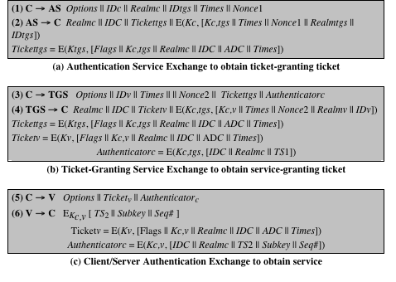
Table 15.3 (page 479 in textbook)
Summary of Kerberos Version 5 Message Exchanges
Notes:
Table 15.3 summarizes the basic version
5 dialogue. This is best explained by comparison with version 4 (Table 15.1).
First, consider the authentication service exchange . Message (1) is a client request
for a ticket-granting ticket. As before, it includes the ID of the user and the TGS.
The following new elements are added:
■ Realm: Indicates realm of user
■ Options: Used to request that certain flags be set in the returned ticket
■ Times: Used by the client to request the following time settings in the ticket:
—from: the desired start time for the requested ticket
—till: the requested expiration time for the requested ticket
—rtime: requested renew-till time
■ Nonce: A random value to be repeated in message (2) to assure that the response
is fresh and has not been replayed by an opponent
Message (2) returns a ticket-granting ticket, identifying information for the
client, and a block encrypted using the encryption key based on the user’s password.
This block includes the session key to be used between the client and the TGS,
times specified in message (1), the nonce from message (1), and TGS identifying
information. The ticket itself includes the session key, identifying information for
the client, the requested time values, and flags that reflect the status of this ticket
and the requested options. These flags introduce significant new functionality to
version 5. For now, we defer a discussion of these flags and concentrate on the overall
structure of the version 5 protocol.
Let us now compare the ticket-granting service exchange for versions
4 and 5. We see that message (3) for both versions includes an authenticator, a
ticket, and the name of the requested service. In addition, version 5 includes requested
times and options for the ticket and a nonce—all with functions similar
to those of message (1). The authenticator itself is essentially the same as the one
used in version 4.
Message (4) has the same structure as message (2). It returns a ticket plus
information needed by the client, with the information encrypted using the session
key now shared by the client and the TGS.
Finally, for the client/server authentication exchange , several new features
appear in version 5. In message (5), the client may request as an option that mutual
authentication is required. The authenticator includes several new fields:
■ Subkey: The client’s choice for an encryption key to be used to protect this
specific application session. If this field is omitted, the session key from the
ticket (K_{c,v} ) is used.
■ Sequence number: An optional field that specifies the starting sequence number
to be used by the server for messages sent to the client during this session.
Messages may be sequence numbered to detect replays.
If mutual authentication is required, the server responds with message (6).
This message includes the timestamp from the authenticator. Note that in version 4,
the timestamp was incremented by one. This is not necessary in version 5, because
the nature of the format of messages is such that it is not possible for an opponent
to create message (6) without knowledge of the appropriate encryption keys.
The subkey field, if present, overrides the subkey field, if present, in message (5).
The optional sequence number field specifies the starting sequence number to be
used by the client.

Slide 28
Table 15.4
Kerberos Version 5 Flags
(Table can be found on page 480 in textbook)
Notes:
The flags field included in tickets in version 5 supports expanded
functionality compared to that available in version 4. Table 15.4 summarizes the
flags that may be included in a ticket.
The INITIAL flag indicates that this ticket was issued by the AS, not by the
TGS. When a client requests a service-granting ticket from the TGS, it presents a
ticket-granting ticket obtained from the AS. In version 4, this was the only way to
obtain a service-granting ticket. Version 5 provides the additional capability that
the client can get a service-granting ticket directly from the AS. The utility of this is
as follows: A server, such as a password-changing server, may wish to know that the
client’s password was recently tested.
The PRE-AUTHENT flag, if set, indicates that when the AS received the initial
request [message (1)], it authenticated the client before issuing a ticket. The
exact form of this preauthentication is left unspecified. As an example, the MIT
implementation of version 5 has encrypted timestamp preauthentication, enabled
by default. When a user wants to get a ticket, it has to send to the AS a preauthentication
block containing a random confounder, a version number, and a timestamp
all encrypted in the client’s password-based key. The AS decrypts the block and will
not send a ticket-granting ticket back unless the timestamp in the preauthentication
block is within the allowable time skew (time interval to account for clock drift
and network delays). Another possibility is the use of a smart card that generates
continually changing passwords that are included in the preauthenticated messages.
The passwords generated by the card can be based on a user’s password but be
transformed by the card so that, in effect, arbitrary passwords are used. This prevents
an attack based on easily guessed passwords. If a smart card or similar device
was used, this is indicated by the HW-AUTHENT flag.
When a ticket has a long lifetime, there is the potential for it to be stolen and
used by an opponent for a considerable period. If a short lifetime is used to lessen
the threat, then overhead is involved in acquiring new tickets. In the case of a ticketgranting
ticket, the client would either have to store the user’s secret key, which is
clearly risky, or repeatedly ask the user for a password. A compromise scheme is
the use of renewable tickets. A ticket with the RENEWABLE flag set includes two
expiration times: One for this specific ticket and one that is the latest permissible
value for an expiration time. A client can have the ticket renewed by presenting it
to the TGS with a requested new expiration time. If the new time is within the limit
of the latest permissible value, the TGS can issue a new ticket with a new session
time and a later specific expiration time. The advantage of this mechanism is that
the TGS may refuse to renew a ticket reported as stolen.
A client may request that the AS provide a ticket-granting ticket with the
MAY-POSTDATE flag set. The client can then use this ticket to request a ticket
that is flagged as POSTDATED and INVALID from the TGS. Subsequently, the
client may submit the postdated ticket for validation. This scheme can be useful
for running a long batch job on a server that requires a ticket periodically. The
client can obtain a number of tickets for this session at once, with spread out time
values. All but the first ticket are initially invalid. When the execution reaches a
point in time when a new ticket is required, the client can get the appropriate ticket
validated. With this approach, the client does not have to repeatedly use its ticketgranting
ticket to obtain a service-granting ticket.
In version 5, it is possible for a server to act as a proxy on behalf of a client, in
effect adopting the credentials and privileges of the client to request a service from
another server. If a client wishes to use this mechanism, it requests a ticket-granting
ticket with the PROXIABLE flag set. When this ticket is presented to the TGS, the
TGS is permitted to issue a service-granting ticket with a different network address;
this latter ticket will have its PROXY flag set. An application receiving such a ticket
may accept it or require additional authentication to provide an audit trail.
The proxy concept is a limited case of the more powerful forwarding procedure.
If a ticket is set with the FORWARDABLE flag, a TGS can issue to the requestor a
ticket-granting ticket with a different network address and the FORWARDED flag
set. This ticket then can be presented to a remote TGS. This capability allows a client
to gain access to a server on another realm without requiring that each Kerberos
maintain a secret key with Kerberos servers in every other realm. For example,
realms could be structured hierarchically. Then a client could walk up the tree to a
common node and then back down to reach a target realm. Each step of the walk
would involve forwarding a ticket-granting ticket to the next TGS in the path.

Slide 29
Mutual Authentication
Public-key encryption for session key distribution
Assumes each of the two parties is in possession of the current public key of the other
May not be practical to require this assumption
Denning protocol using timestamps
Uses an authentication server (AS) to provide public-key certificates
Requires the synchronization of clocks
Woo and Lam makes use of nonces
Care needed to ensure no protocol flaws
Notes:
In Chapter 14, we presented one approach to the use of public-key encryption for
the purpose of session-key distribution (Figure 14.9). This protocol assumes that
each of the two parties is in possession of the current public key of the other. It may
not be practical to require this assumption.
A protocol using timestamps is provided in [DENN81]
In this case, the central system is referred to as an authentication server (AS),
because it is not actually responsible for secret-key distribution. Rather, the AS provides
public-key certificates. The session key is chosen and encrypted by A; hence,
there is no risk of exposure by the AS. The timestamps protect against replays of
compromised keys.
This protocol is compact but, as before, requires the synchronization of clocks.
Another approach, proposed by Woo and Lam [WOO92a], makes use of nonces.
This seems to be a secure protocol that takes into account the various attacks.
However, the authors themselves spotted a flaw and submitted a revised version of
the algorithm.
In both this example and the protocols described earlier, protocols that appeared
secure were revised after additional analysis. These examples highlight the
difficulty of getting things right in the area of authentication.

Slide 30
One-Way Authentication
Have public-key approaches for e-mail
Encryption of message for confidentiality, authentication, or both
The public-key algorithm must be applied once or twice to what may be a long message
For confidentiality encrypt message with one-time secret key, public-key encrypted
If authentication is the primary concern, a digital signature may suffice
Notes:
We have already presented public-key encryption approaches that are suited to electronic mail, including the straightforward encryption of the entire message for confidentiality (Figure 12.1b), authentication (Figure 12.1c), or both (Figure 12.1d). These approaches require that either the sender know the recipient's public key (confidentiality) or the recipient know the sender's public key (authentication) or both (confidentiality plus authentication). In addition, the public-key algorithm must be applied once or twice to what may be a long message.
If confidentiality is the primary concern, then better to encrypt the message with a one-time secret key, and also encrypt this one-time key with B's public key. If authentication is the primary concern, then a digital signature may suffice (but could be replaced by an opponent). To counter such a scheme, both the message and signature can be encrypted with the recipient's public key. The latter two schemes require that B know A's public key and be convinced that it is timely. An effective way to provide this assurance is the digital certificate.
If authentication is the primary concern, then a digital signature may suffice.

Slide 31
Federated Identity Management
Relatively new concept dealing with the use of a common identity management scheme across multiple enterprise and numerous applications and supporting many users
Services provided include:
Point of contact
SSO protocol services
Trust services
Key services
Identity services
Authorization
Provisioning
Management
Notes:
Federated identity management is a relatively new concept dealing with the use of
a common identity management scheme across multiple enterprises and numerous
applications and supporting many thousands, even millions, of users. We begin our
overview with a discussion of the concept of identity management and then examine
federated identity management.
Typical services provided by a federated identity management system include
the following:
• Point of contact: Includes authentication that a user corresponds to the user
name provided, and management of user/server sessions.
• SSO protocol services: Provides a vendor-neutral security token service for
supporting a single sign on to federated services.
• Trust services: Federation relationships require a trust relationship-based
federation between business partners. A trust relationship is represented by
the combination of the security tokens used to exchange information about a
user, the cryptographic information used to protect these security tokens, and
optionally the identity mapping rules applied to the information contained
within this token.
• Key services: Management of keys and certificates.
• Identity services: services that provide the interface to local data stores,
including user registries and databases, for identity-related information
management.
• Authorization: Granting access to specific services and/or resources based on
the authentication.
• Provisioning: Includes creating an account in each target system for the user,
enrollment or registration of user in accounts, establishment of access rights or
credentials to ensure the privacy and integrity of account data.
• Management: Services related to runtime configuration and deployment.

Slide 32
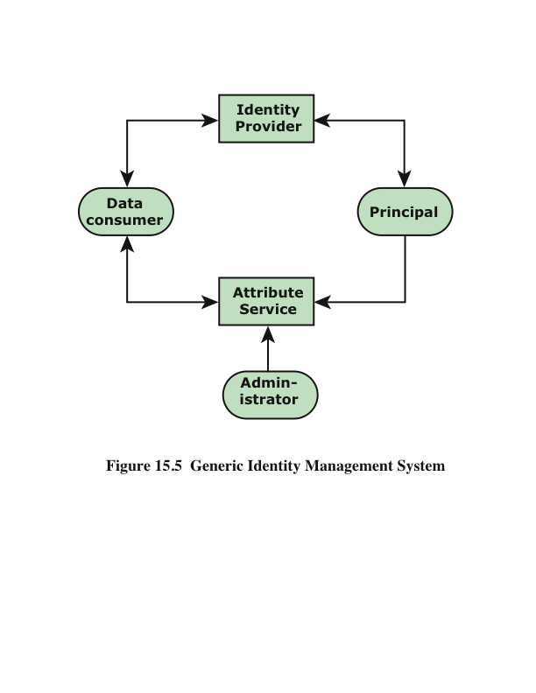
Notes:
Figure 15.5 illustrates entities and data flows in a generic identity management
architecture. A principal is an identity holder. Typically, this is a human user
that seeks access to resources and services on the network. User devices, agent processes,
and server systems may also function as principals. Principals authenticate
themselves to an identity provider . The identity provider associates authentication
information with a principal, as well as attributes and one or more identifiers.
Increasingly, digital identities incorporate attributes other than simply
an identifier and authentication information (such as passwords and biometric
information). An attribute service manages the creation and maintenance of such
attributes. For example, a user needs to provide a shipping address each time an
order is placed at a new Web merchant, and this information needs to be revised
when the user moves. Identity management enables the user to provide this information
once, so that it is maintained in a single place and released to data consumers
in accordance with authorization and privacy policies. Users may create some
of the attributes to be associated with their digital identity, such as an address.
Administrators may also assign attributes to users, such as roles, access permissions,
and employee information.
Data consumers are entities that obtain and employ data maintained and
provided by identity and attribute providers, which are often used to support authorization
decisions and to collect audit information. For example, a database server
or file server is a data consumer that needs a client’s credentials so as to know what
access to provide to that client.

Slide 33
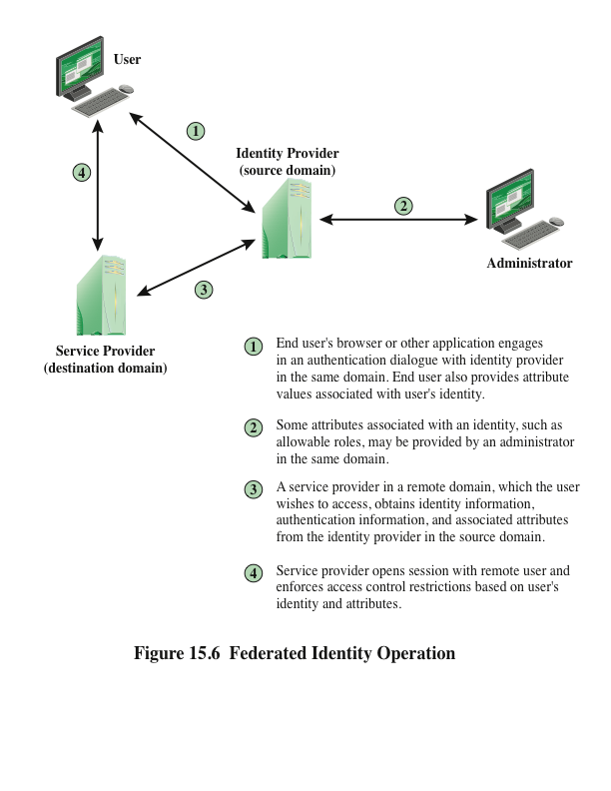
Notes:
Identity federation is, in essence, an extension of identity management to
multiple security domains. Such domains include autonomous internal business
units, external business partners, and other third-party applications and services.
The goal is to provide the sharing of digital identities so that a user can be authenticated
a single time and then access applications and resources across multiple
domains. Because these domains are relatively autonomous or independent, no
centralized control is possible. Rather, the cooperating organizations must form a
federation based on agreed standards and mutual levels of trust to securely share
digital identities.
Federated identity management refers to the agreements, standards, and
technologies that enable the portability of identities, identity attributes, and entitlements
across multiple enterprises and numerous applications and supporting many
thousands, even millions, of users. When multiple organizations implement interoperable
federated identity schemes, an employee in one organization can use a single
sign-on to access services across the federation with trust relationships associated
with the identity. For example, an employee may log onto her corporate intranet
and be authenticated to perform authorized functions and access authorized services
on that intranet. The employee could then access their health benefits from an
outside health-care provider without having to re-authenticate.
Beyond SSO, federated identity management provides other capabilities. One
is a standardized means of representing attributes. Increasingly, digital identities
incorporate attributes other than simply an identifier and authentication information
(such as passwords and biometric information). Examples of attributes include
account numbers, organizational roles, physical location, and file ownership. A user
may have multiple identifiers; for example, each identifier may be associated with a
unique role with its own access permissions.
Another key function of federated identity management is identity mapping.
Different security domains may represent identities and attributes differently.
Further, the amount of information associated with an individual in one domain
may be more than is necessary in another domain. The federated identity management
protocols map identities and attributes of a user in one domain to the requirements
of another domain.
Figure 15.6 illustrates entities and data flows in a generic federated identity
management architecture.
The identity provider acquires attribute information through dialogue and
protocol exchanges with users and administrators. For example, a user needs to
provide a shipping address each time an order is placed at a new Web merchant,
and this information needs to be revised when the user moves. Identity management
enables the user to provide this information once, so that it is maintained in
a single place and released to data consumers in accordance with authorization
and privacy policies.
Service providers are entities that obtain and employ data maintained and
provided by identity providers, often to support authorization decisions and to
collect audit information. For example, a database server or file server is a data
consumer that needs a client’s credentials so as to know what access to provide to
that client. A service provider can be in the same domain as the user and the identity
provider. The power of this approach is for federated identity management,
in which the service provider is in a different domain (e.g., a vendor or supplier
network).

Slide 34
Key Standards
The Extensible Markup Language (XML)
A markup language that uses sets of embedded tags or labels to characterize text elements within a document so as to indicate their appearance, function, meaning, or context
The Simple Object Access Protocol (SOAP)
Enables applications to request services from one another with XML-based requests and receive responses as data formatted with XML
WS-Security
A set of SOAP extensions for implementing message integrity and confidentiality in Web services
Security Assertion Markup Language (SAML)
An XML-based language for the exchange of security information between online business partners
Notes:
Federated identity management uses a number of standards as the
building blocks for secure identity exchange across different domains or heterogeneous
systems. In essence, organizations issue some form of security tickets for their
users that can be processed by cooperating partners. Identity federation standards
are thus concerned with defining these tickets, in terms of content and format, providing
protocols for exchanging tickets and performing a number of management
tasks. These tasks include configuring systems to perform attribute transfers and
identity mapping, and performing logging and auditing functions. The key standards
are as follows:
• The Extensible Markup Language (XML): A markup language that uses sets
of embedded tags or labels to characterize text elements within a document
so as to indicate their appearance, function, meaning, or context. XML documents
appear similar to HTML (Hypertext Markup Language) documents
that are visible as Web pages, but provide greater functionality. XML includes
strict definitions of the data type of each field, thus supporting database formats
and semantics. XML provides encoding rules for commands that are
used to transfer and update data objects.
• The Simple Object Access Protocol (SOAP): A minimal set of conventions
for invoking code using XML over HTTP. It enables applications to request
services from one another with XML-based requests and receive responses
as data formatted with XML. Thus, XML defines data objects and structures,
and SOAP provides a means of exchanging such data objects and performing
remote procedure calls related to these objects. See [ROS06] for an informative
discussion.
• WS-Security: A set of SOAP extensions for implementing message integrity
and confidentiality in Web services. To provide for secure exchange of SOAP
messages among applications, WS-Security assigns security tokens to each
message for use in authentication.
• Security Assertion Markup Language (SAML): An XML-based language
for the exchange of security information between online business partners.
SAML conveys authentication information in the form of assertions about
subjects. Assertions are statements about the subject issued by an authoritative
entity.
The challenge with federated identity management is to integrate multiple
technologies, standards, and services to provide a secure, user-friendly utility. The
key, as in most areas of security and networking, is the reliance on a few mature
standards widely accepted by industry. Federated identity management seems to
have reached this level of maturity.

Slide 35
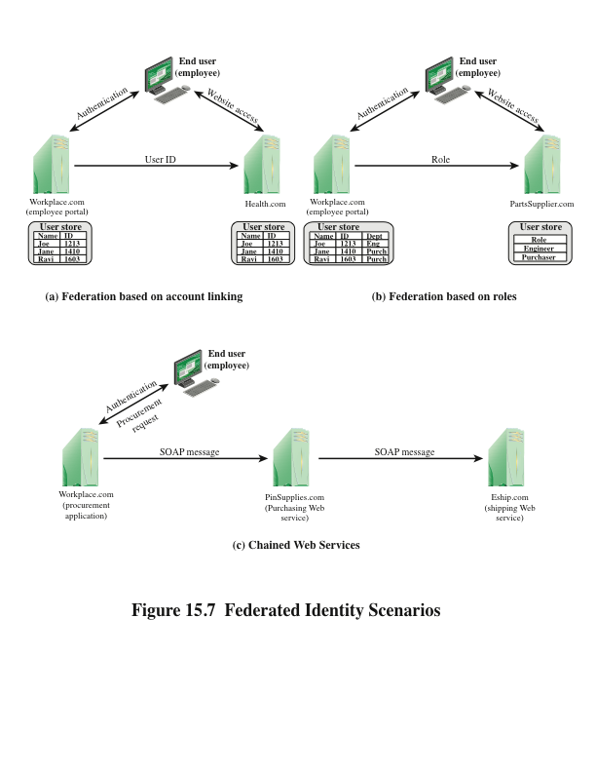
Notes:
To get some feel for the functionality of identity federation, we look at three scenarios, taken from [COMP06]
In the first scenario (Figure 15.7a), Workplace.com contracts with Health.com
to provide employee health benefits. An employee uses a Web interface to sign on to
Workplace.com and goes through an authentication procedure there. This enables
the employee to access authorized services and resources at Workplace.com. When
the employee clicks on a link to access health benefits, her browser is redirected to
Health.com. At the same time, the Workplace.com software passes the user’s identifier
to Health.com in a secure manner. The two organizations are part of a federation
that cooperatively exchanges user identifiers. Health.com maintains user identities
for every employee at Workplace.com and associates with each identity health-benefits
information and access rights. In this example, the linkage between the two companies
is based on account information and user participation is browser based.
Figure 15.7b shows a second type of browser-based scheme. PartsSupplier.
com is a regular supplier of parts to Workplace.com. In this case, a role-based
access-control (RBAC) scheme is used for access to information. An engineer of
Workplace.com authenticates at the employee portal at Workplace.com and clicks
on a link to access information at PartsSupplier.com. Because the user is authenticated
in the role of an engineer, he is taken to the technical documentation and
troubleshooting portion of PartsSupplier.com’s Web site without having to sign on.
Similarly, an employee in a purchasing role signs on at Workplace.com and is authorized,
in that role, to place purchases at PartsSupplier.com without having to
authenticate to PartsSupplier.com. For this scenario, PartsSupplier.com does not
have identity information for individual employees at Workplace.com. Rather, the
linkage between the two federated partners is in terms of roles.
The scenario illustrated in Figure 15.7c can be referred to as document based
rather than browser based. In this third example, Workplace.com has a purchasing
agreement with PinSupplies.com, and PinSupplies.com has a business relationship
with E-Ship.com. An employee of Workplace.com signs on and is authenticated to
make purchases. The employee goes to a procurement application that provides a
list of Workplace.com’s suppliers and the parts that can be ordered. The user clicks
on the PinSupplies button and is presented with a purchase order Web page (HTML
page). The employee fills out the form and clicks the submit button. The procurement
application generates an XML/SOAP document that it inserts into the envelope
body of an XML-based message. The procurement application then inserts the
user’s credentials in the envelope header of the message, together with Workplace.
com’s organizational identity. The procurement application posts the message to
the PinSupplies.com’s purchasing Web service. This service authenticates the incoming
message and processes the request. The purchasing Web service then sends
a SOAP message to its shipping partner to fulfill the order. The message includes
a PinSupplies.com security token in the envelope header and the list of items to be
shipped as well as the end user’s shipping information in the envelope body. The
shipping Web service authenticates the request and processes the shipment order.

Slide 36
Personal Identity Verification
User authentication based on the possession of a smart card is becoming more widespread
Has the appearance of a credit card
Has an electronic interface
May use a variety of authentication protocols
A smart card contains within it an entire microprocessor, including processor, memory, and I/O ports
A smart card includes three types of memory:
Read-only memory (ROM) stores data that does not change during the card’s life
Electronically erasable programmable ROM (EEPROM) holds application data and programs; also holds data that may vary with time
Random access memory (RAM) holds temporary data generated when applications are executed
Notes:
User authentication based on the possession of a smart card is becoming more widespread.
A smart card has the appearance of a credit card, has an electronic interface,
and may use a variety of authentication protocols.
A smart card contains within it an entire microprocessor, including processor,
memory, and I/O ports. Some versions incorporate a special co-processing circuit
for cryptographic operation to speed the task of encoding and decoding messages or
generating digital signatures to validate the information transferred. In some cards,
the I/O ports are directly accessible by a compatible reader by means of exposed
electrical contacts. Other cards rely instead on an embedded antenna for wireless
communication with the reader.
A typical smart card includes three types of memory. Read-only memory
(ROM) stores data that does not change during the card’s life, such as the card
number and the cardholder’s name. Electrically erasable programmable ROM
(EEPROM) holds application data and programs, such as the protocols that the
card can execute. It also holds data that may vary with time. For example, in a telephone
card, the EEPROM holds the talk time remaining. Random access memory
(RAM) holds temporary data generated when applications are executed.
For the practical application of smart card authentication, a wide range of
vendors must conform to standards that cover smart card protocols, authentication
and access control formats and protocols, database entries, message formats, and so
on. An important step in this direction is FIPS 201-2 (Personal Identity Verification
[PIV] of Federal Employees and Contractors , June 2012). The standard defines a
reliable, government-wide PIV system for use in applications such as access to federally
controlled facilities and information systems. The standard specifies a PIV
system within which common identification credentials can be created and later
used to verify a claimed identity. The standard also identifies Federal government-wide
requirements for security levels that are dependent on risks to the facility or
information being protected. The standard applies to private-sector contractors as
well, and serves as a useful guideline for any organization.

Slide 37
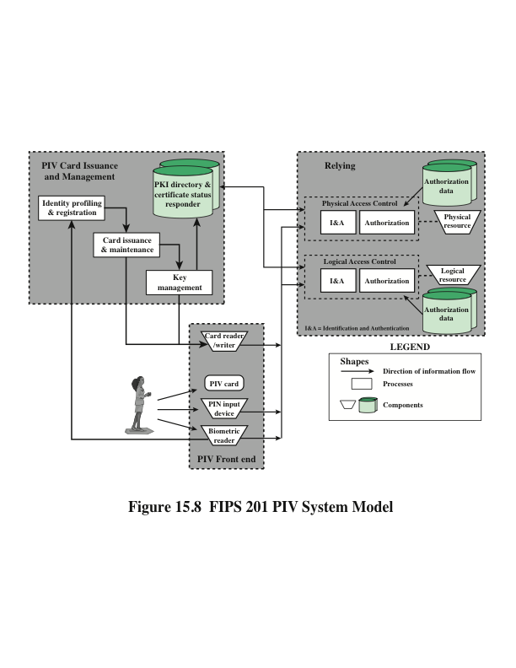
Notes:
Figure 15.8 illustrates the major components of FIPS 201-2 compliant systems. The
PIV front end defines the physical interface to a user who is requesting access to a
facility, which could be either physical access to a protected physical area or logical
access to an information system. The PIV front-end subsystem supports up to
three-factor authentication; the number of factors used depends on the level of security
required. The front end makes use of a smart card, known as a PIV card,
which is a dual-interface contact and contactless card. The card holds a cardholder
photograph, X.509 certificates, cryptographic keys, biometric data, and a cardholder
unique identifier (CHUID). Certain cardholder information may be read-protected
and require a personal identification number (PIN) for read access by the card
reader. The biometric reader, in the current version of the standard, is a fingerprint
reader or an iris scanner.
The standard defines three assurance levels for verification of the card and the
encoded data stored on the card, which in turn leads to verifying the authenticity of
the person holding the credential. A level of some confidence corresponds to use of
the card reader and PIN. A level of high confidence adds a biometric comparison
of a fingerprint captured and encoded on the card during the card-issuing process
and a fingerprint scanned at the physical access point. A very high confidence level
requires that the process just described is completed at a control point attended by
an official observer.
The other major component of the PIV system is the PIV card issuance and
management subsystem . This subsystem includes the components responsible for
identity proofing and registration, card and key issuance and management, and the
various repositories and services (e.g., public key infrastructure [PKI] directory, certificate
status servers) required as part of the verification infrastructure.
The PIV system interacts with a relying subsystem , which includes components
responsible for determining a particular PIV cardholder’s access to a physical
or logical resource. FIPS 201-2 standardizes data formats and protocols for interaction
between the PIV system and the relying system.
Unlike the typical card number/facility code encoded on most access control
cards, the FIPS 201 CHUID takes authentication to a new level, through the use of
an expiration date (a required CHUID data field) and an optional CHUID digital signature.
A digital signature can be checked to ensure that the CHUID recorded on the
card was digitally signed by a trusted source and that the CHUID data have not been
altered since the card was signed. The CHUID expiration date can be checked to verify
that the card has not expired. This is independent from whatever expiration date is associated
with cardholder privileges. Reading and verifying the CHUID alone provides
only some assurance of identity because it authenticates the card data, not the cardholder.
The PIN and biometric factors provide identity verification of the individual.

Slide 38
PIV Documentation
FIPS 201-2—Personal Identity Verification (PIV) of Federal Employees and Contractors
Specifies the physical card characteristics, storage media, and data elements that make up the identity credentials resident on the PIV card
SP 800-73-3—Interfaces for Personal Identity Verification
Specifies the interfaces and card architecture for storing and retrieving identity credentials from a smart card, and provides guidelines for the use of authentication mechanisms and protocols
SP 800-76-2—Biometric Data Specification for Personal Identity Verification
Describes technical acquisition and formatting specifications for the biometric credentials of the PIV system
SP 800-78-3—Cryptographic Algorithms and Key Sizes for Personal Identity Verification
Identifies acceptable symmetric and asymmetric encryption algorithms, digital signature algorithms, and message digest algorithms, and specifies mechanisms to identify the algorithms associated with PIV keys or digital signatures
SP 800-104—A Scheme for PIV Visual Card Topography
Provides additional recommendations on the PIV card color-coding for designating employee affiliation
SP 800-116—A Recommendation for the Use of PIV Credentials in Physical Access Control Systems (PACS)
Describes a risk-based approach for selecting appropriate PIV authentication mechanisms to manage physical access to Federal government facilities and assets
SP 800-79-1—Guidelines for the Accreditation of Personal Identity Verification Card Issuers
Provides guidelines for accrediting the reliability of issuers of PIV cards that collect, store, and disseminate personal identity credentials and issue smart cards
SP 800-96—PIV Card to Reader Interoperability Guidelines
Provides requirements that facilitate interoperability between any card and any reader
Notes:
The PIV specification is quite complex, and NIST has issued a number of documents
that cover a broad range of PIV topics. These are as follows:
• FIPS 201-2—Personal Identity Verification (PIV) of Federal Employees
and Contractors: Specifies the physical card characteristics, storage media,
and data elements that make up the identity credentials resident on the
PIV card.
• SP 800-73-3—Interfaces for Personal Identity Verification: Specifies the interfaces
and card architecture for storing and retrieving identity credentials from
a smart card, and provides guidelines for the use of authentication mechanisms
and protocols.
• SP 800-76-2—Biometric Data Specification for Personal Identity Verification:
Describes technical acquisition and formatting specifications for the biometric
credentials of the PIV system.
• SP 800-78-3—Cryptographic Algorithms and Key Sizes for Personal Identity
Verification: Identifies acceptable symmetric and asymmetric encryption
algorithms, digital signature algorithms, and message digest algorithms, and
specifies mechanisms to identify the algorithms associated with PIV keys or
digital signatures.
• SP 800-104—A Scheme for PIV Visual Card Topography: Provides additional
recommendations on the PIV card color-coding for designating employee
affiliation.
• SP 800-116—A Recommendation for the Use of PIV Credentials in Physical
Access Control Systems (PACS): Describes a risk-based approach for selecting
appropriate PIV authentication mechanisms to manage physical access to
Federal government facilities and assets.
• SP 800-79-1—Guidelines for the Accreditation of Personal Identity
Verification Card Issuers: Provides guidelines for accrediting the reliability
of issuers of PIV cards that collect, store, and disseminate personal identity
credentials and issue smart cards.
• SP 800-96—PIV Card to Reader Interoperability Guidelines: Provides
requirements that facilitate interoperability between any card and any
reader.

Slide 39
PIV Credentials and Keys
Personal Identification Number (PIN)
Required to activate the card for privileged operation
Cardholder Unique Identifier (CHUID)
Includes the Federal Agency Smart Credential Number (FASC-N) and the Global Unique Identification Number (GUID), which uniquely identify the card and the cardholder
PIV Authentication Key
Asymmetric key pair and corresponding certificate for user authentication
Two fingerprint templates
For biometric authentication
Electronic facial image
For biometric authentication
Asymmetric Card Authentication Key
Asymmetric key pair and corresponding certificate used for card authentication
Optional elements include the following:
Digital Signature Key
Asymmetric key pair and corresponding certificate that supports document signing and signing of data elements such as the CHUID
Key Management Key
Asymmetric key pair and corresponding certificate supporting key establishment and transport
Symmetric Card Authentication Key
For supporting physical access applications
PIV Card Application Administration Key
Symmetric key associated with the card management system
One or two iris images
For biometric authentication
Notes:
The PIV card contains a number of mandatory and optional data elements that
serve as identity credentials with varying levels of strength and assurance. These
credentials are used singly or in sets to authenticate the holder of the PIV card to
achieve the level of assurance required for a particular activity or transaction. The
mandatory data elements are the following:
• Personal Identification Number (PIN): Required to activate the card for privileged
operation.
• Cardholder Unique Identifier (CHUID): Includes the Federal Agency Smart
Credential Number (FASC-N) and the Global Unique Identification Number
(GUID), which uniquely identify the card and the cardholder.
• PIV Authentication Key: Asymmetric key pair and corresponding certificate
for user authentication.
• Two fingerprint templates: For biometric authentication.
• Electronic facial image: For biometric authentication.
• Asymmetric Card Authentication Key: Asymmetric key pair and corresponding
certificate used for card authentication.
Optional elements include the following:
• Digital Signature Key: Asymmetric key pair and corresponding certificate
that supports document signing and signing of data elements such as the
CHUID.
• Key Management Key: Asymmetric key pair and corresponding certificate
supporting key establishment and transport.
• Symmetric Card Authentication Key: For supporting physical access
applications.
• PIV Card Application Administration Key: Symmetric key associated with
the card management system.
• One or two iris images: For biometric authentication.

Slide 40
Table 15.5
PIV Algorithms and Key Sizes
Notes:
Table 15.5 lists the algorithm and key size requirements for PIV key types.

Slide 41
Authentication
Using the electronic credentials resident on a PIV card, the card supports the following authentication mechanisms:
CHUID
The cardholder is authenticated using the signed CHUID data element on the card. The PIN is not required. This mechanism is useful in environments where a low level of assurance is acceptable and rapid contactless authentication is necessary
Card Authentication Key
The PIV card is authenticated using the Card Authentication Key in a challenge response protocol. The PIN is not required. This mechanism allows contact (via card reader) or contactless (via radio waves) authentication of the PIV card without the holder’s active participation, and provides a low level of assurance
• BIO
The cardholder is authenticated by matching his or her fingerprint sample(s) to the signed biometric data element in an environment without a human attendant in view. The PIN is required to activate the card. This mechanism achieves a high level of assurance and requires the cardholder’s active participation is submitting the PIN as well as the biometric sample
BIO-A
The cardholder is authenticated by matching his or her fingerprint sample(s) to the signed biometric data element in an environment with a human attendant in view. The PIN is required to activate the card. This mechanism achieves a very high level of assurance when coupled with full trust validation of the biometric template retrieved from the card, and requires the cardholder’s active participation is submitting the PIN as well as the biometric sample
• PKI
The cardholder is authenticated by demonstrating control of the PIV authentication private key in a challenge response protocol that can be validated using the PIV authentication certificate. The PIN is required to activate the card. This mechanism achieves a very high level of identity assurance and requires the cardholder’s knowledge of the PIN
Notes:
Using the electronic credentials resident on a PIV card, the card supports the
following authentication mechanisms:
• CHUID: The cardholder is authenticated using the signed CHUID data
element on the card. The PIN is not required. This mechanism is useful in
environments where a low level of assurance is acceptable and rapid contactless
authentication is necessary.
• Card Authentication Key: The PIV card is authenticated using the Card
Authentication Key in a challenge response protocol. The PIN is not required.
This mechanism allows contact (via card reader) or contactless (via radio
waves) authentication of the PIV card without the holder’s active participation,
and provides a low level of assurance.
• BIO: The cardholder is authenticated by matching his or her fingerprint
sample(s) to the signed biometric data element in an environment without a
human attendant in view. The PIN is required to activate the card. This mechanism
achieves a high level of assurance and requires the cardholder’s active
participation is submitting the PIN as well as the biometric sample.
• BIO-A: The cardholder is authenticated by matching his or her fingerprint
sample(s) to the signed biometric data element in an environment with a
human attendant in view. The PIN is required to activate the card. This mechanism
achieves a very high level of assurance when coupled with full trust
validation of the biometric template retrieved from the card, and requires the
cardholder’s active participation is submitting the PIN as well as the biometric
sample.
• PKI: The cardholder is authenticated by demonstrating control of the PIV
authentication private key in a challenge response protocol that can be validated
using the PIV authentication certificate. The PIN is required to activate
the card. This mechanism achieves a very high level of identity assurance and
requires the cardholder’s knowledge of the PIN.
In each of the above use cases, except the symmetric Card Authentication Key
use case, the source and the integrity of the corresponding PIV credential are validated
by verifying the digital signature on the credential, with the signature being
provided by a trusted entity.

Slide 42
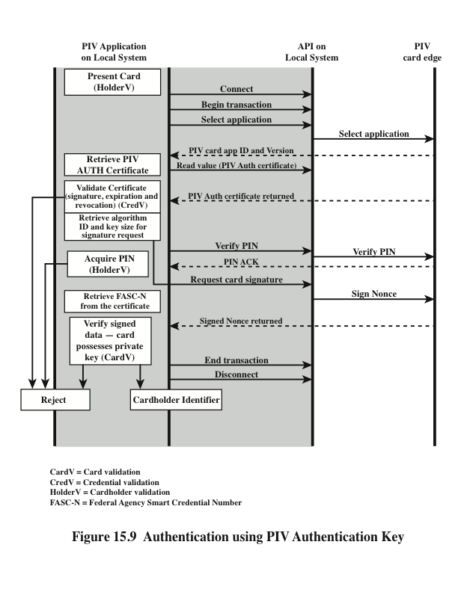
Notes:
A variety of protocols can be constructed for each of these authentication
types. SP-800-78-3 gives examples for each type. Figure 15.9 illustrates an authentication
scenario that includes the use of the PIV Authentication Key. This scenario
provides a high level of assurance. This scenario would be appropriate for authentication
of a user who possesses a PIV card and seeks access to a computer resource.
The computer, designated local system in the figure, includes PIV application
software and communicates to the card via an application program interface that
enables the use of relatively high-level procedure calls. These high-level commands
are converted into PIV commands that are issued to the card through a physical
interface via a card reader or via a wireless interface. In either case, SP-800-73 refers
to the card command interface as the PIV card edge.
The process begins when the local system detects the card either through an
attached card reader or wirelessly. It then selects an application on the card for authentication.
The local system then requests the public-key certificate for the card’s
PIV Authentication Key. If the certificate is valid (i.e., has a valid signature, has not
expired or been revoked), authentication continues. Otherwise the card is rejected.
The next step is for the local system to request that the cardholder enter the PIN
for the card. If the submitted PIN matches the PIN stored on the card, the card
returns a positive acknowledgment; otherwise the card returns a failure message.
The local system either continues or rejects the card accordingly. The next phase is
a challenge-response protocol. The local system sends a nonce to be signed by the
PIV, and the PIV returns the signature. The local system uses the PIV authentication
public key to verify the signature. If the signature is valid, the cardholder is accepted
as being identified. Otherwise the local system rejects the card.
The scenario of Figure 15.9 accomplishes three types of authentication. The
combination of possession of the card and knowledge of the PIN service authenticates
the cardholder. The PIV Authentication Key certificate validates the card’s
credentials. The challenge-response protocol authenticates the card.

Slide 43
Summary
Remote user-authentication principles
The NIST model for electronic user authentication
Means of authentication
Mutual authentication
One-way authentication
Remote user-authentication using symmetric encryption
Mutual authentication
One-way authentication
Kerberos
Motivation
Kerberos V4 and V5
Remote user-authentication using asymmetric encryption
Mutual authentication
One-way authentication
Federated identity management
Identity management
Identity federation
Personal identity verification
PIV system model
PIV documentation
PIV credentials and keys
Authentication
Notes:
Chapter 15 summary.

